Slide 1

Yelp Recommender System
CSYE 7200 Final Project
Team 9: Zenan Lin | Yiqiang Wang | Wen Zhong

Slide 2
Background
In today’s information ear, information overload is inevitable
People are hard to distinguish useful information
Producer are rarely get attention from users
So, a recommender system is shown to solve this dilemma
Valuate user’s information and recommend some similar product they might interested
Product display to who needs it

Slide 3

Use Case
In this scenario, we will implement a recommendation system that recommend restaurants for each user, based on his or her consumption rating records.
Based on the records (considered as dataset), we take preference of every user for each restaurant. User may rate from different degrees when considering if it is tasty or cheap. We take all ratings into a formula and get a rating point. Now we have a data frame with [user, item and rating].
The algorithm SVD we use takes a standard dataset. And its output will fill all blanks that restaurant doesn’t rated by any user. As a result, we’ll have either origin or prediction a value that every user rates for a restaurant.
So, we can easily get the top N restaurants that have highest scores for each user. If we combine this recommendation list with distance and rating time, we’ll have an advanced list which is our final output.
Notes:
explicit feedback,

Slide 4
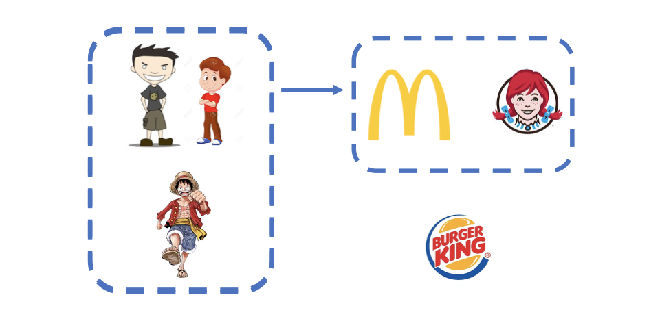
Scenario

Slide 5

Methodology
Generating training set as the table below
Recommend point = rating + price + distance (filtered by distance, ordered by point)
rating = (star * weight1 +... + useful*weightN) * weightT
We use the 80 percent of data to make the fill matrix, and using the 20 percent of the data to test.
Based on this recommendation system, we recommend 10 restaurants to the user. And using the test data calculate the top 10 rating restaurant.
Generating recommendation list
Show result: recommendation list for each user
User | Item | Rating
user1 | restaurant1 | 2
user2 | restaurant1 | 4

Slide 6
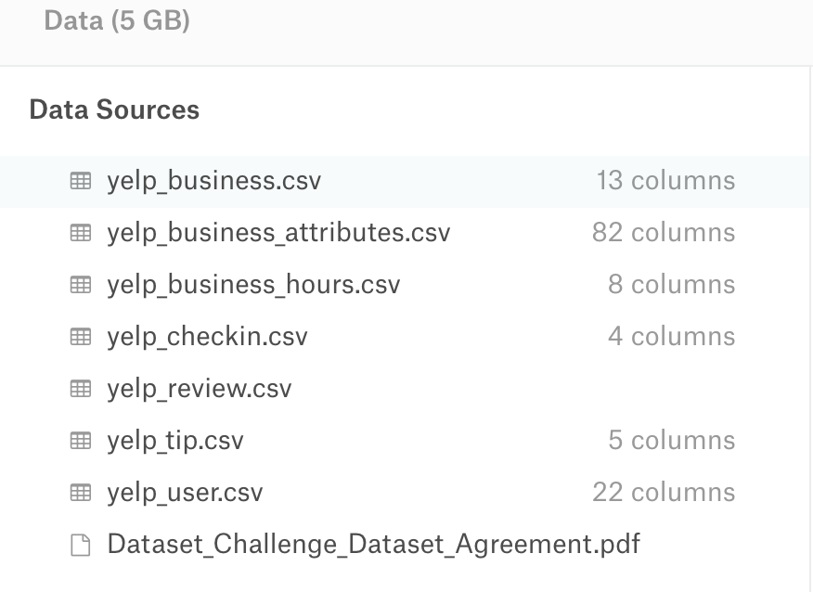
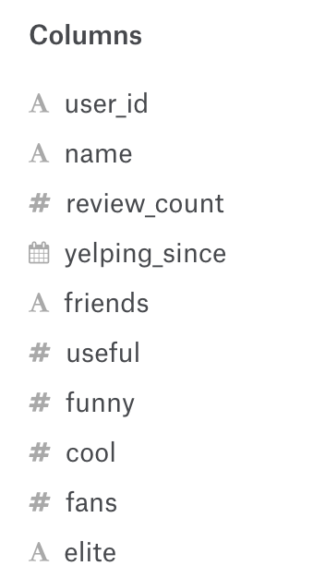

Datasets
Original Data:
5,200,000 user reviews
Information on 174,000 businesses
Yelp Dataset: https://www.kaggle.com/yelp-dataset/yelp-dataset
What we need:
user: review, restaurant, star, funny, useful
restaurant: id name city/state location

Slide 7
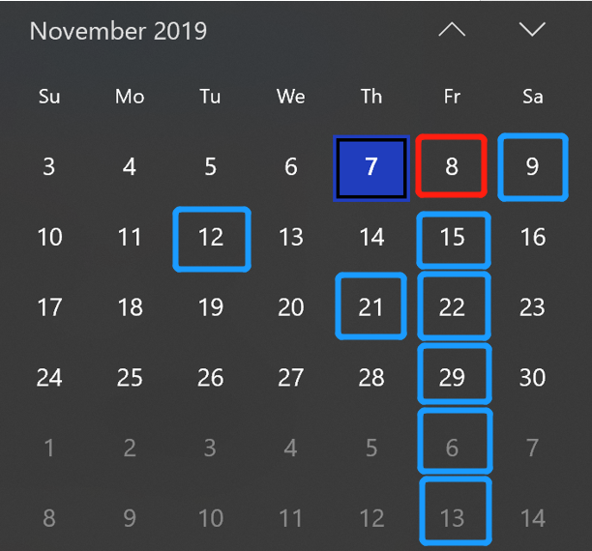
Timeline - Yelp Recommender System
Goals：To design a recommender system based on user’s preference
We are here
Planning
Implementing
Verification
Done!!
11-12 Obtain
processed data
Challenge1: Choose
appropriate algorithm
11-09 Pre
-clean data
11-21 Initial result
11-26 Initial visulization
11-29
Wrap-up
11-08 Build planer
11-15 Testing algorithm
11-22
Applying API
Challenge2: Make a
nice visulization
12-06
Final check
11-08
11-12
11-15
11-21
11-22
11-29
12-06
12-13
2019/11/08 | 2019/11/09 | 2019/11/12 | 2019/11/15 | 2019/11/21 | 2019/11/22 | 2019/11/26 | 2019/11/29 | 2019/12/06
Build planer; Schedule tasks. | Process data; Clean no need features. | Should have clean data; Ready to test on algorithm | Testing on the algorithm; Choose an appropriate one. | Get initial result after running algorithm. | Importing API into project. | Initial visualization. | Almost done; Verify the project and reorganize to clean project. | Done!! Have a final check with everything.
Milestone
Completed
In-Progress
To-dos
Challenge
Current progress

Slide 8
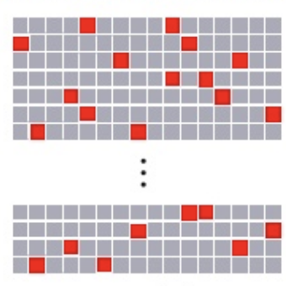
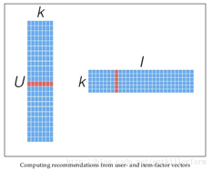

Code
Project repsotpry: https://github.com/NeilLin85/CSYE7200_yelp_recommend
We implement SVD algorithm for recommendation
The code will be in 3 parts: Data cleaning, Model running and Result generating

Slide 9
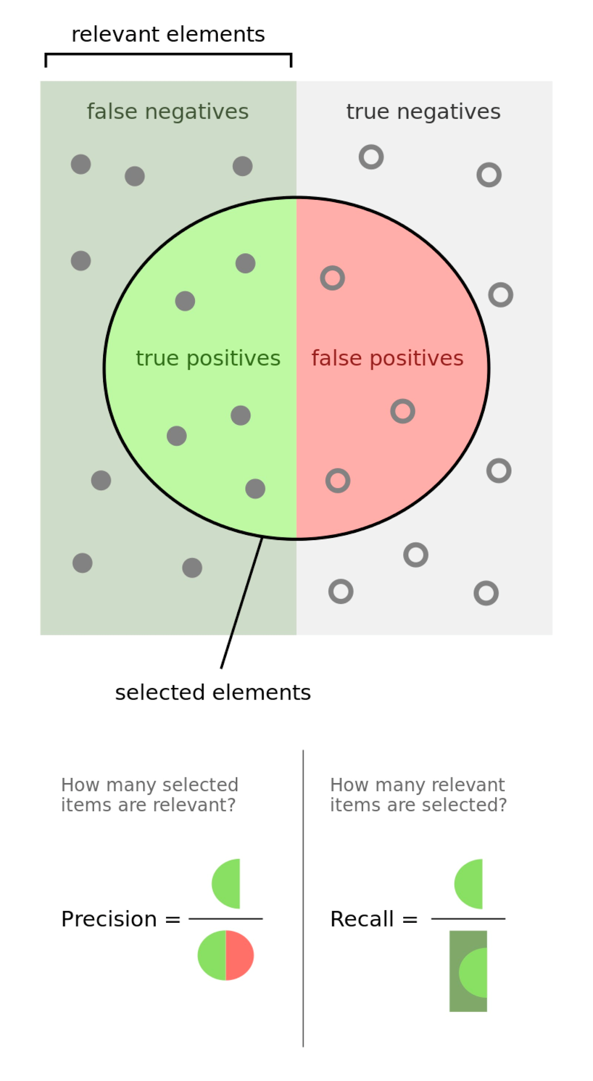
Acceptance criteria
Recall: describes how many being liked items we select from all items that users really like
Precise: describes how many being liked items we choose from all selection
We assume the precise score of 0.7, and the recall value of 0.8

Slide 10

Goals
For each user recommend items from different categories. List = n1 from categories + n2 from categories + n3 from categories 3 + …(n1 + n2 + n3 + … = recommendation list count )
For a better performance, we take user preferrence, distance and review time into consideration.
User | Recommend list
User1 | Recommend list []
User2 | Recommend list []
User3 | Recommend list []
User4 | Recommend list []

Slide 11
Potential issues
What if theres a new user comes into this system?
Recommend him of top-n in each cates
It does work that if give out a personalized suggestion by his characters when registration, but not necessary.
How to locate a user when calculating the distance?
Choose a pin on maps and suppose that to be a real-time location
This model can only calculate off-line, which means that is not a real-time solution. We have no idea to deal with it. It’s a natural drawback of this algorithm.

